Slide 1
Machine Learning Lecture – 3
Machine Learning Model

Slide 2
3. Basic Concepts and Ideals of Machine Learning
3.1 Designing versus Learning
In daily life, people are easily facing some decisions to make. For example, if the sky is cloudy, we may decide to bring an umbrella or not.
For a machine to make these kinds of choices, the intuitive way is to model the problem into a mathematical expression. The mathematical expression could directly be designed from the problem background. For instance, the vending machine could use the standards and security decorations of currency to detect false money.
While in some other problems that we can only acquire several measurements and the corresponding labels, but do not know the specific relationship among them, learning will be a better way to find the underlying connection.

Slide 3
Another great illustration to distinguish designing from learning is the image compression technique. JPEG, the most widely used image compression standard, exploits the block-based DCT to extract the spatial frequencies and then unequally quantizes each frequency component to achieve data compression. The success of using DCT comes from not only the image properties, but also the human visual perception. While without counting the side information, the KL transform (Karhunen-Loeve transform), which learns the best projection basis for a given image, has been proved to best reduce the redundancy [11]. In many literatures, the knowledge acquired from human understandings or the intrinsic factors of problems
are called the domain knowledge. And the knowledge learned from a given training set is called the data-driven knowledge.

Slide 4
3.2 The Categorization of Machine Learning
There are generally three types of machine learning based on the ongoing problem and the given data set, (1) supervised learning, (2) unsupervised learning, and (3) reinforcement learning:
Supervised learning: The training set given for supervised learning is the labeled dataset defined. Supervised learning tries to find the relationships between the feature set and the label set, which is the knowledge and properties we can learn from labeled dataset. If each feature vector x is corresponding to a label y ∈ L, L ={l₁,l₂ ,......,l_{c}} (c is usually ranged
from 2 to a hundred), the learning problem is denoted as classification. On the other hand, if each feature vector x is corresponding to a real value y ∈ R , the learning problem is defined as regression problem. The knowledge extracted from supervised learning is often utilized for prediction and recognition.
Unsupervised learning: The training set given for unsupervised leaning is the unlabeled dataset also defined . Unsupervised learning aims at clustering , probability density estimation, finding association among features, and dimensionality reduction . In general, an unsupervised algorithm may simultaneously learn more than one properties listed above, and the results from unsupervised learning could be further used for supervised learning.
Reinforcement learning: Reinforcement learning is used to solve problems of decision making (usually a sequence of decisions), such as robot perception and movement, automatic chess player, and automatic vehicle driving.
In addition to these three types, a forth type of machine learning category, semi-supervised learning, has attracted increasing attention recently.

Slide 5
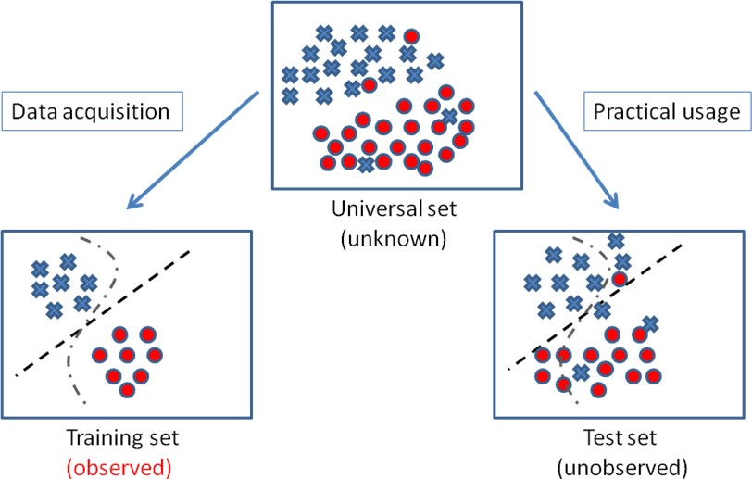

Slide 6
The “No Free Lunch” theorem states that there is no one model that works best for every problem. The assumptions of a great model for one problem may not hold for another problem, so it is common in machine learning to try multiple models and find one that works best for a particular problem.

Slide 7
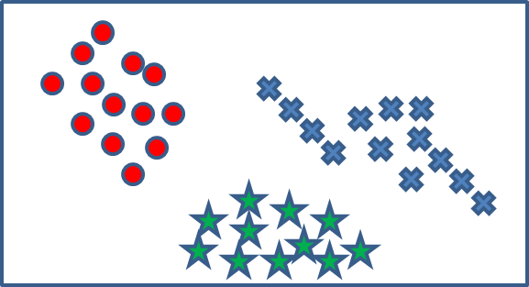
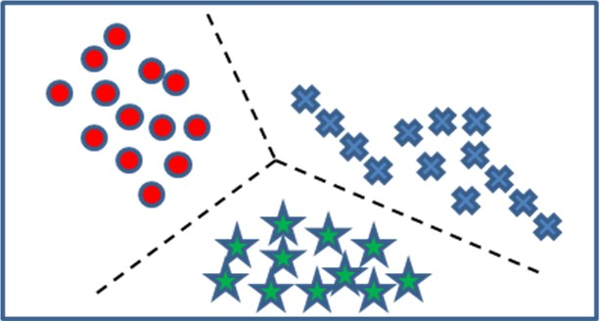
3.3 The Structure of Learning
In this subsection, the structure of machine learning is presented. In order to avoid confusion about the variety of unsupervised learning structures, only the supervised learning structure is shown. While in later sections, several unsupervised learning techniques will still be mentioned and introduced, and important references for further reading are listed. An overall illustration of the supervised learning structure is given in Fig. 7. Above the horizontal dotted line, an unknown target function f (or target distribution) that maps each feature sample in the universal dataset to its corresponding label is assumed to exist. And below the dotted line, a training set coming from the unknown target function is used to learn or approximate the target function. Because there is no idea about the target function or distribution f (looks like a linear boundary or a circular boundary?), a hypothesis set H is necessary to be defined, which contains several hypotheses h (a mapping function or distribution).
Supervised learning: (a) presents a three-class labeled dataset, where the color shows the corresponding label of each sample. After supervised learning, the class-separating boundary could be found as the dotted lines in (b).

Slide 8
Insides the hypothesis set H, the goal of supervised learning is to find the best h, called the final hypothesis g, in some sense approximating the target function f. In order to do so, we need further define the learning algorithm A, which includes the objective function (the function to be optimized for searching g) and the optimization methods. The hypothesis set and the objective function jointly model the property to learn of the no free lunch rules. Finally, the final hypothesis g is expected to approximate f in some way and used for future prediction. Lets see how hypothesis set works with the learning algorithm.

Slide 9
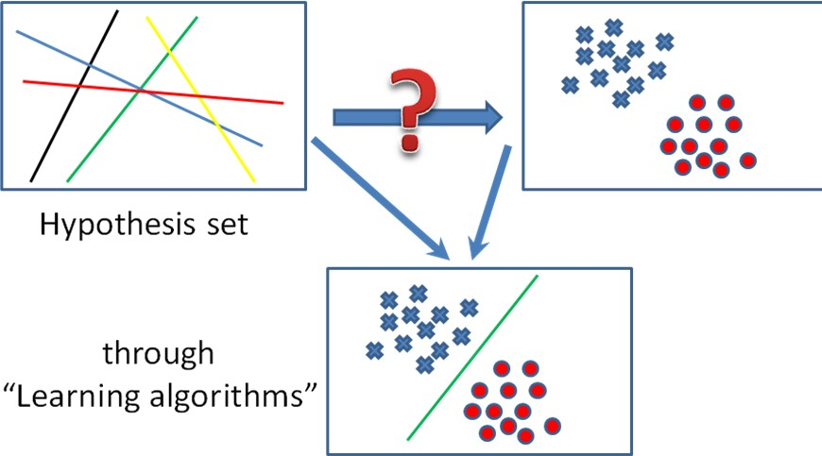
An illustration on hypothesis set and learning algorithm. Take linear classifiers as an example, there are five hypothesis classifiers shown in the up-left rectangle, and in the up-right one, a two-class training set in shown. Through the learning algorithm, the green line is chosen as the most suitable classifier.

Slide 10
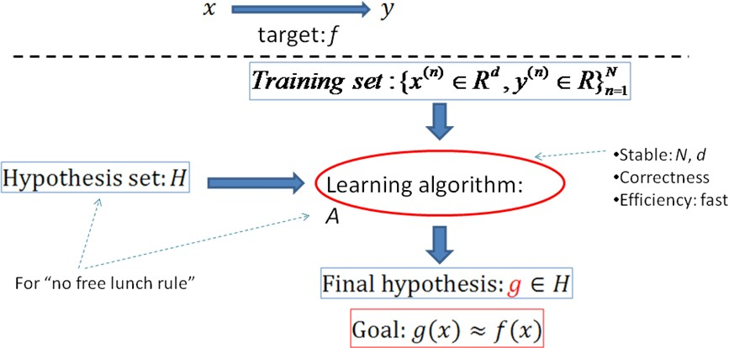

Slide 11
Reinforcement Learning
Consider training a pet dog, we train our pet to bring a ball to us. We throw the ball at a certain distance and ask the dog to fetch it back to us. Every time the dog does this right, we reward the dog. Slowly, the dog learns that doing the job rightly gives him a reward and then the dog starts doing the job right way every time in future. Exactly, this concept is applied in “Reinforcement” type of learning. The technique was initially developed for machines to play games. The machine is given an algorithm to analyze all possible moves at each stage of the game. The machine may select one of the moves at random. If the move is right, the machine is rewarded, otherwise it may be penalized. Slowly, the machine will start differentiating between right and wrong moves and after several iterations would learn to solve the game puzzle with a better accuracy. The accuracy of winning the game would improve as the machine plays more and more games.
The entire process may be depicted in the following diagram:

Slide 12
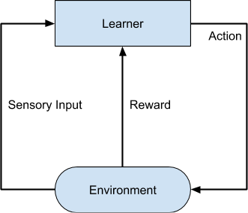
The entire process may be depicted in the following diagram:
This technique of machine learning differs from the supervised learning in that you need not supply the labelled input/output pairs. The focus is on finding the balance between exploring the new solutions versus exploiting the learned solutions.

Slide 13
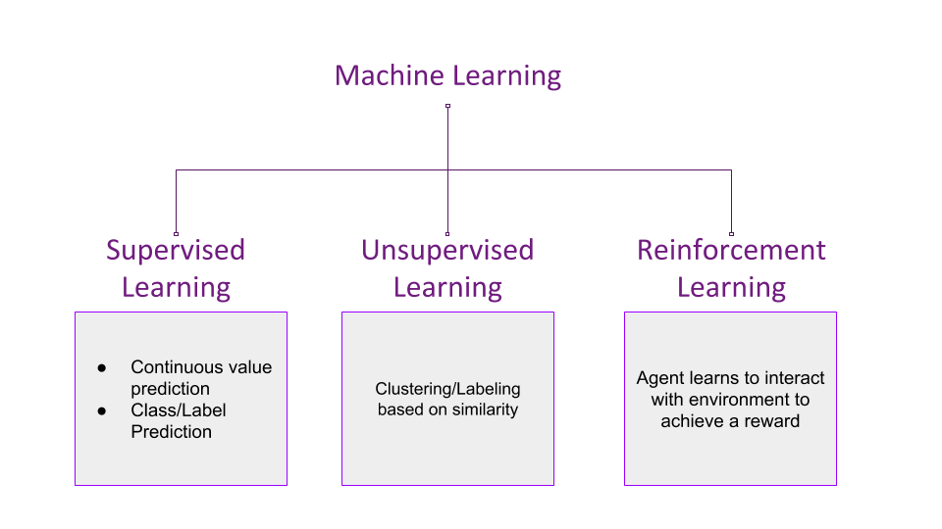

Slide 14
Scenario – Reinforcement
You start walking forward blindly, only counting the number of steps you take. After x steps, you fall into a pit. Your reward was x points since you walked that many steps.
You start again from your initial position, but after x steps, you take a detour either left/right and again move forward. You hit a stone after y steps. This time your reward was y which is greater than x. You decide to take this path again but with more caution.
When you start again, you make a detour after x steps, another after y steps and manage to fall into another pit after z steps. This time the reward was z points which was greater than y, and you decide that this is a good path to take again.
You restart again, make the detours after x, y and z steps to reach the other side of the field. Thus, you've learned to cross the field without the need of light.

Slide 15
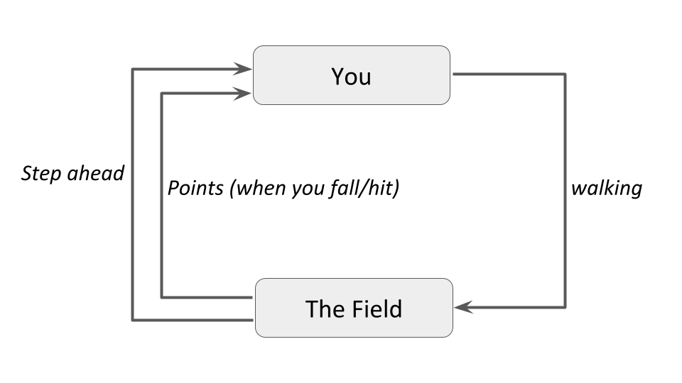

Slide 16
Basic Concept and Terminology
Insight
In the above example, you are the agent who is trying to walk across the field, which is the environment. Walking is the action the agent performs on the environment. The distance the agent walks acts as the reward. The agent tries to perform the action in such a way that the reward maximizes. This is how Reinforcement Learning works in a nutshell.

Slide 17
Terminology
Some important terms related to reinforcement learning are (These terms are taken from Steeve Huang's post on Introduction to Various Reinforcement Learning Algorithms. Part I)-
Agent: a hypothetical entity which performs actions in an environment to gain some reward.
Action (a): All the possible moves that the agent can take.
Environment (e): A scenario the agent has to face.
State (s): Current situation returned by the environment.
Reward (R): An immediate return sent back from the environment to evaluate the last action by the agent.
Policy (π): The strategy that the agent employs to determine next action based on the current state.
Value (V): The expected long-term return with discount, as opposed to the short-term reward R. Vπ(s), is defined as the expected long-term return of the current state s under policy π.
Q-value or action-value (Q): Q-value is similar to Value, except that it takes an extra parameter, the current action a. Qπ(s, a) refers to the long-term return of the current state s, taking action a under policy π.

Slide 18
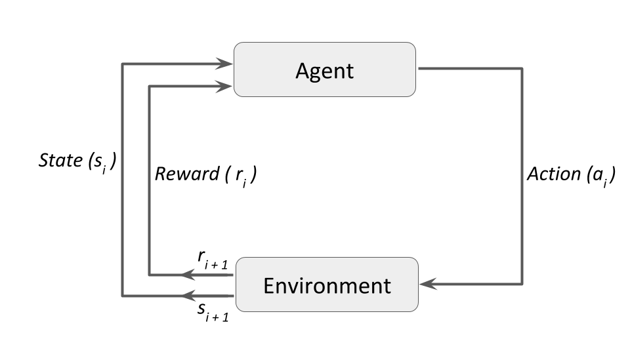

Slide 19
Session 3 ends here.
Any Questions ????

